Slide 1
NAIKI
PRESENTED BY:
SUBHAN → 22K-4316
AHMED →22K-4384

Slide 2
Introduction:
NAIKI is a platform connecting donors with people who need financial assistance.
NAIKI serves four types of people: Patients, Unemployed individuals, Students, and Loan recipients.
NAIKI provides a transparent and efficient way for people to seek financial support.
NAIKI aims to alleviate financial burdens and create a sense of community and support.

Slide 3
Background:
NAIKI was created to help alleviate financial burdens for those in need.
The idea for NAIKI came from the challenges people face when seeking financial assistance.
NAIKI provides a transparent and efficient way for people to seek help and support.
NAIKI was created with the goal of connecting donors with people in need.
NAIKI creates a sense of community and support among its users.

Slide 4
Methodology:
Inheritance
Polymorphism
Abstraction
Encapsulation
Dynamic Memory
Downcasting

Slide 5
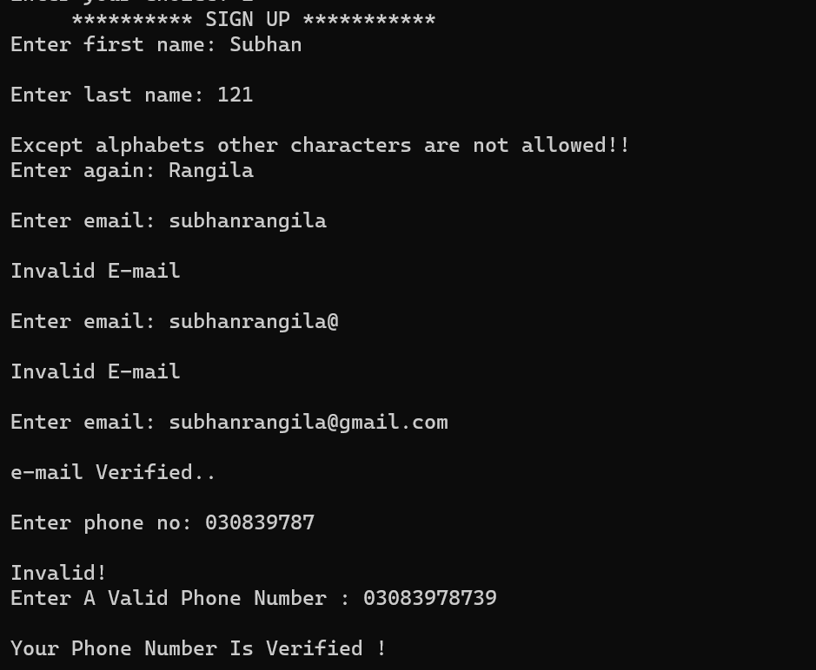
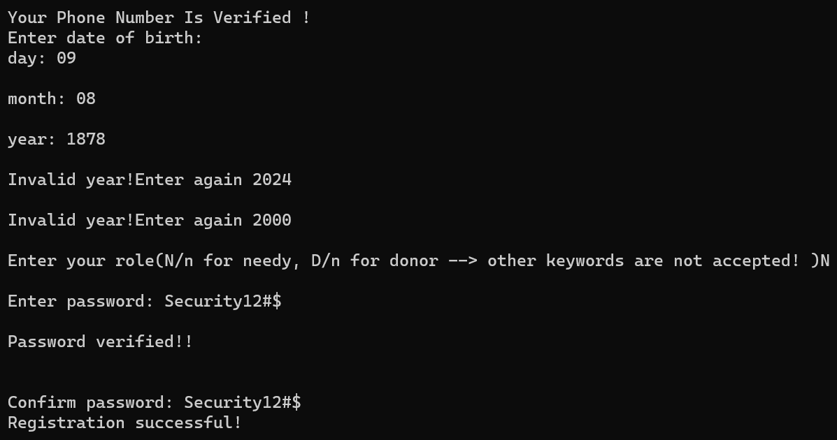
Results/Functionalities: signup:
1: SignUp:

Slide 6
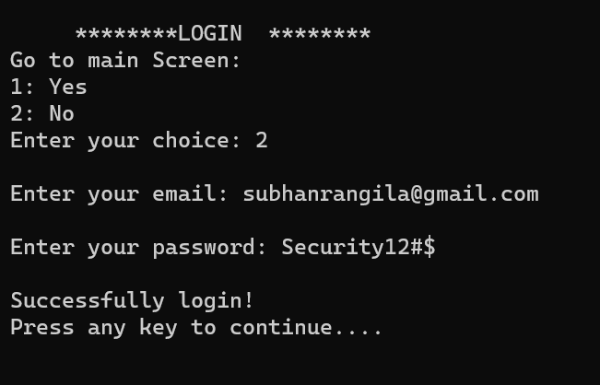
Login:

Slide 7
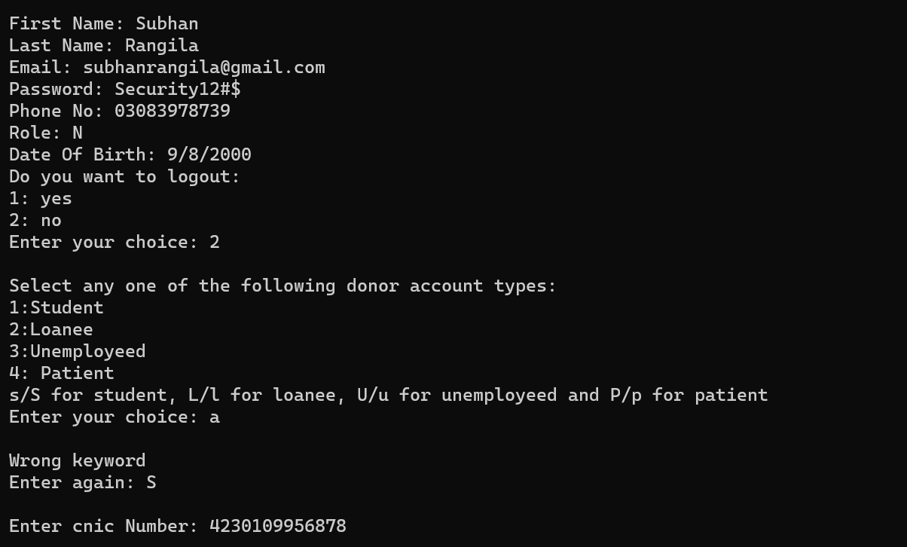
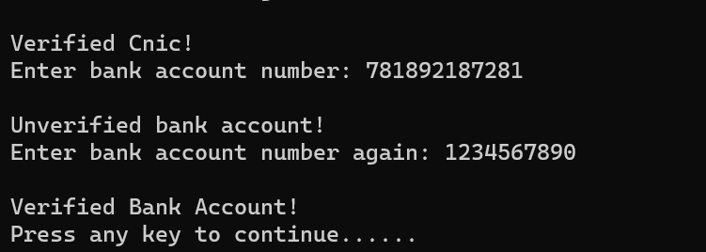
Profile Verification:

Slide 8
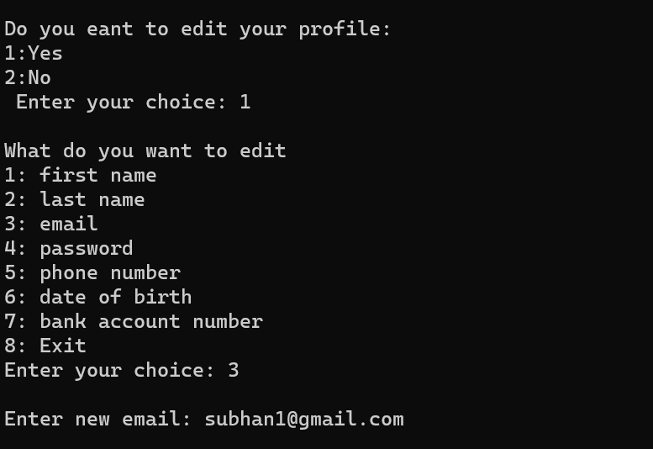
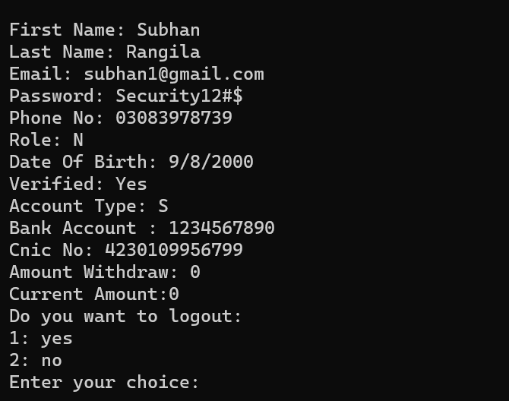
Edit Profile:

Slide 9
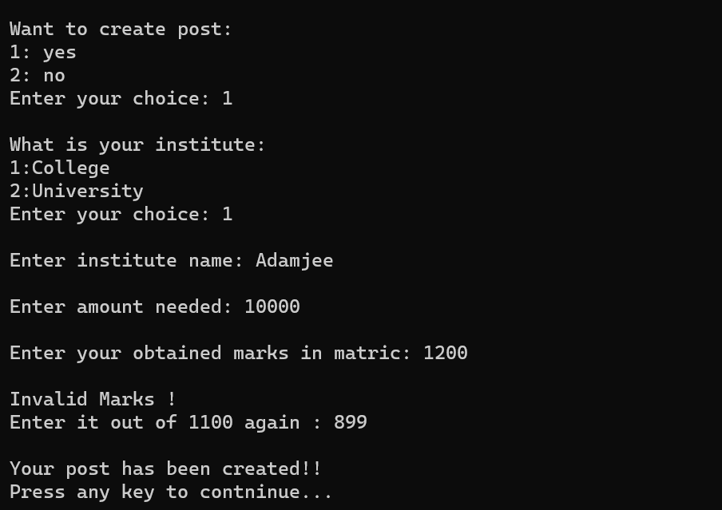
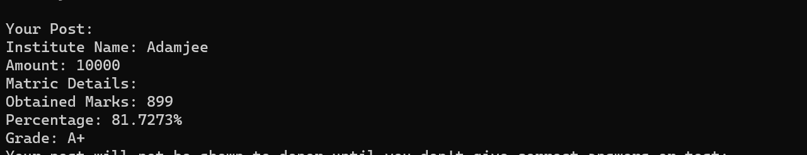
Creating a Post:

Slide 10
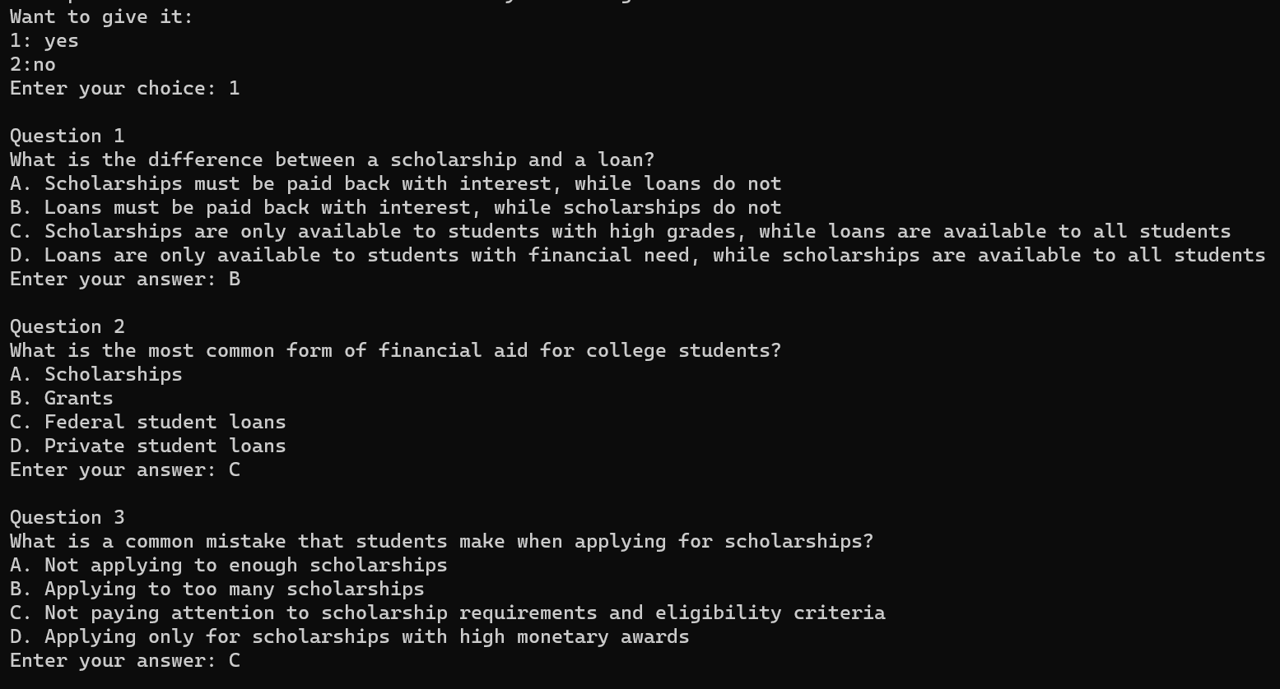
Test Taken:

Slide 11
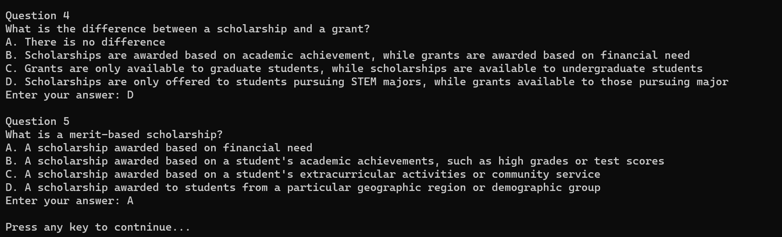
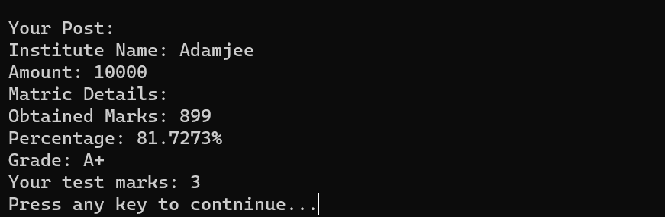

Slide 12
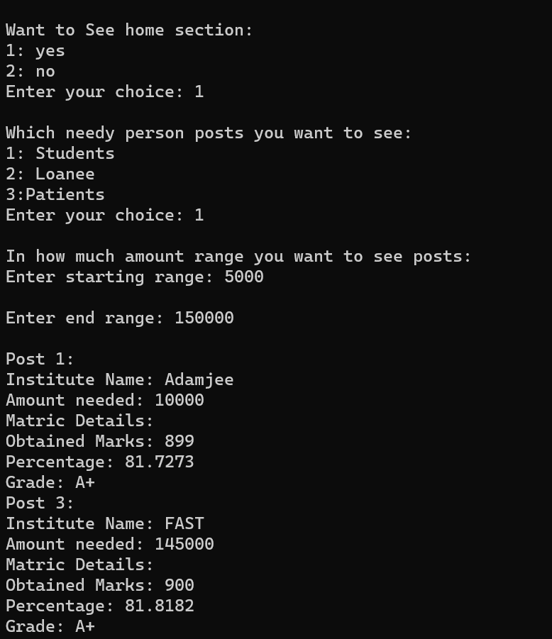
Donate Action:

Slide 13
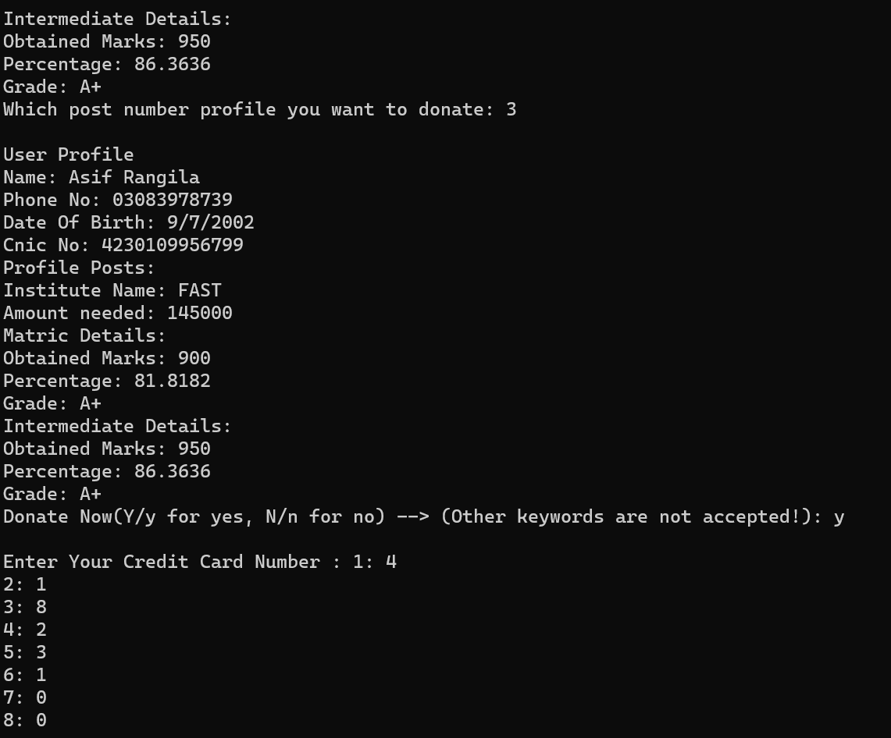

Slide 14
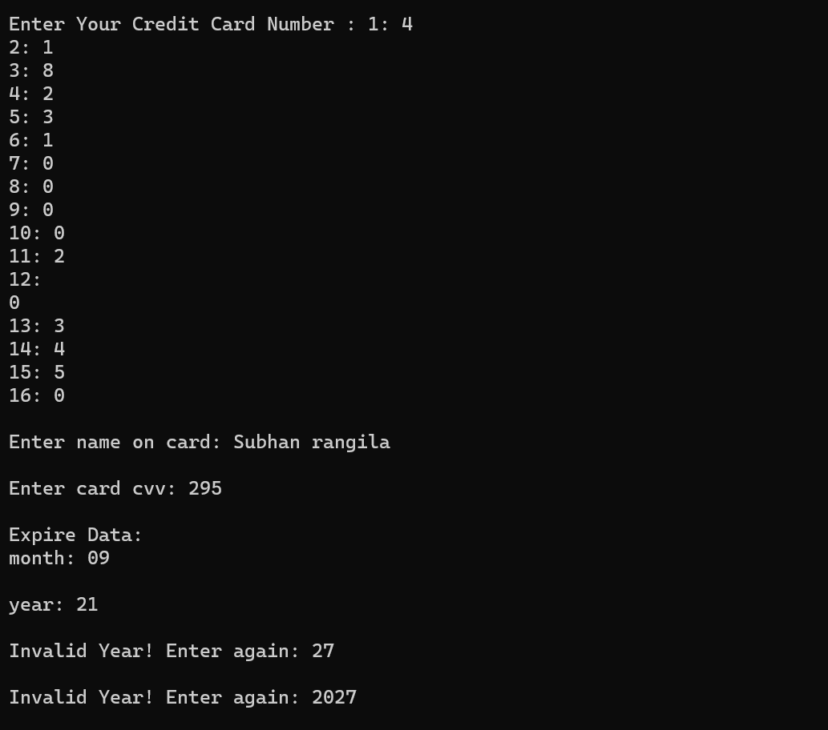

Slide 15

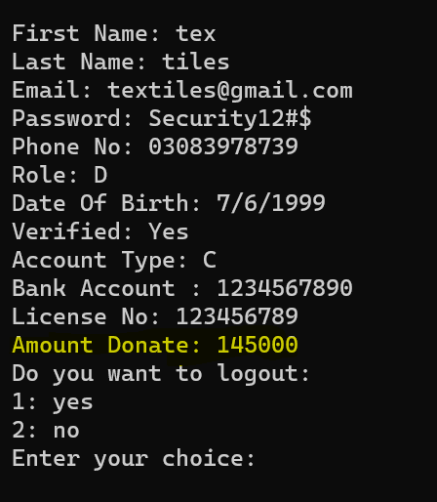

Slide 16
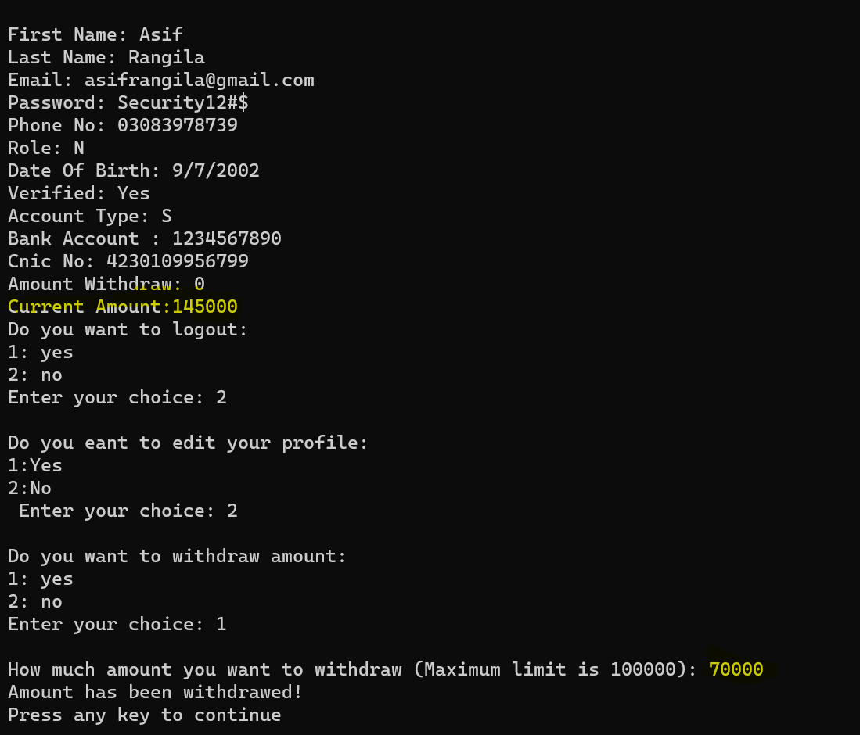
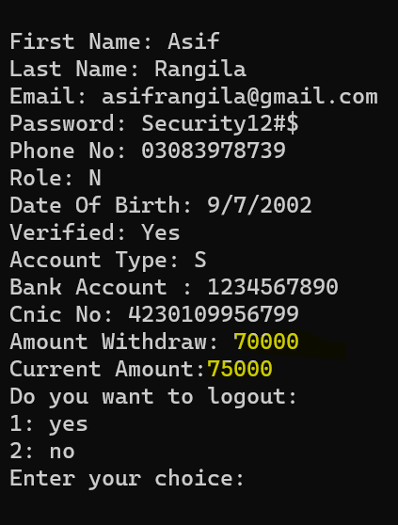
Withdraw:

Slide 17
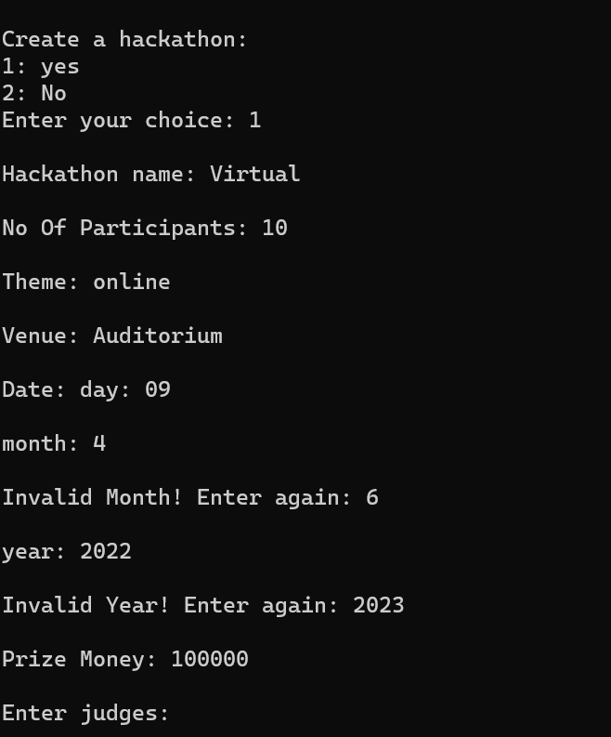
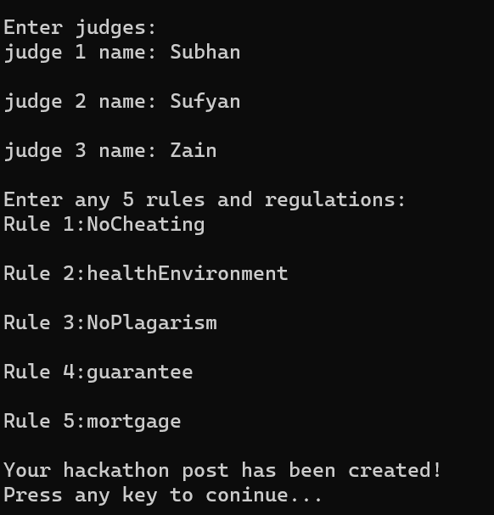
Hackathon Creation:

Slide 18
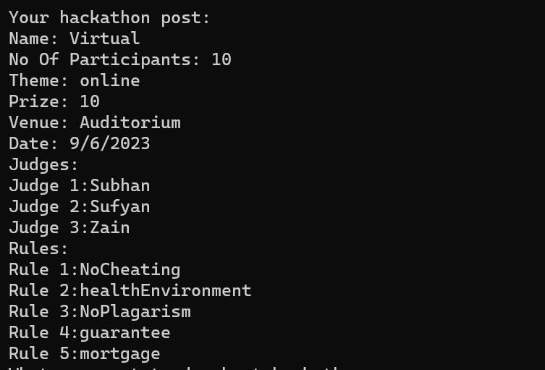

Slide 19
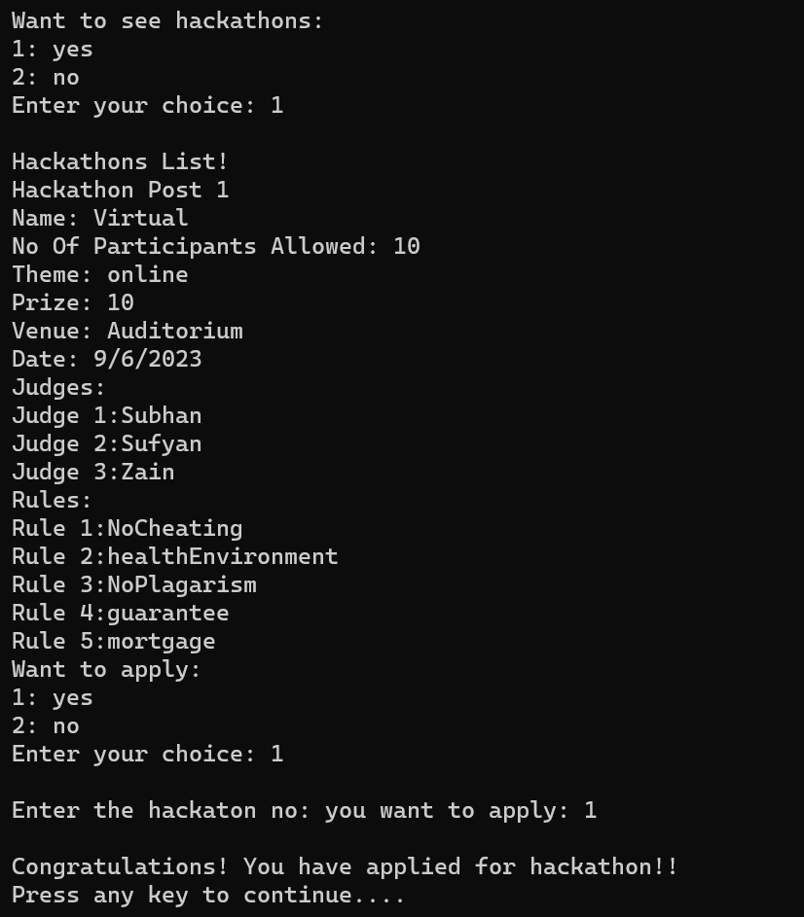
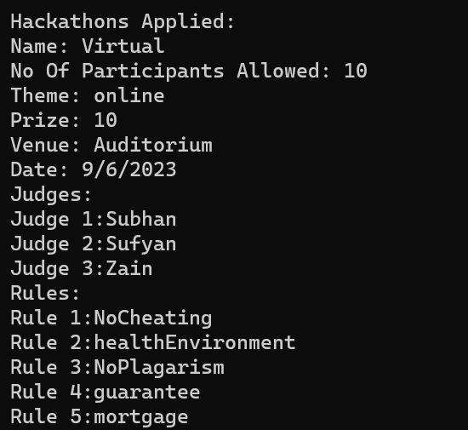
Hackathon Apply:

Slide 20
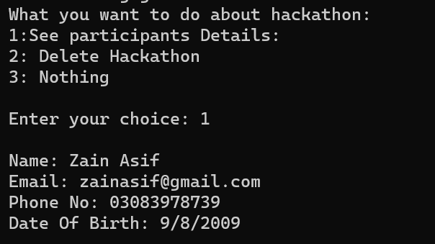
See Participant:

Slide 21
Conclusion:
NAIKI helps those in need of financial assistance.
NAIKI aims to make a positive impact on people's lives.

